Slide 1
PYTHON:
Subprograms

Slide 2
Learning Objective
Understand what a subprogram is.
Learn how to write a subprogram.

Slide 3
Subprogram
What is it?
A Subprogram is a self-contained sequence of program instructions that performs a specific task. Using subprograms allows the production of more effective code. A subprogram is called whenever it is needed to carry out that function. Subprograms are also called subroutines.

Slide 4
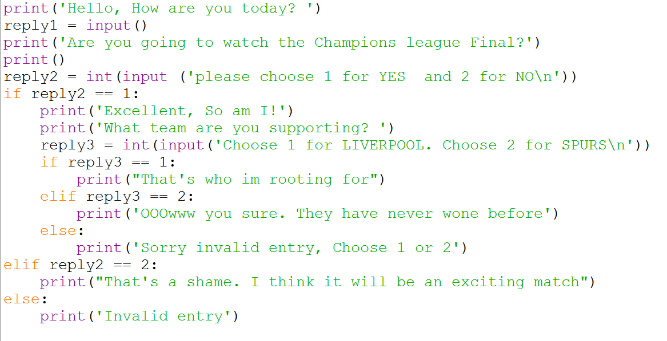
Starter Activity Answer
22

Slide 5
Name some in built functions and procedures that we use in python.
print
if
input
for
etc
Slicing
else
While
Random
.append
indexing

Slide 6
The use of subprograms
They:
Allow the production of structured code.
Make programs shorter – the code only needs to be written once and can be called as many times as needed.
Make program code easier to read and test.
Shorten the development time of a program.
Make testing easier.
Make code more readable.

Slide 7
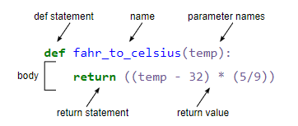
Types of subprograms
What is a Function?.
What is a Procedure?
What is a Parameters?

Slide 8
Types of subprograms
A Function is a subprogram that returns a value to the main program when it is called.
A Procedure is a subprogram that carries out a specific task but does not return values to the main program.
Values passed to the function from the main program are stored in the subprogram’s Parameters.

Slide 9
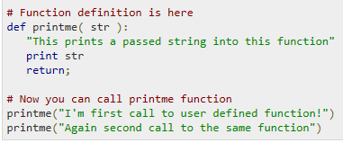
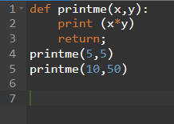

Slide 10
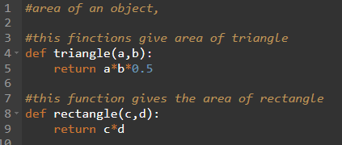
EXAMPLE:
Start with defining the functions.

Slide 11
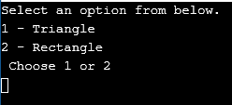
EXAMPLE: - cont.
Creating a menu.
Code being run.

Slide 12

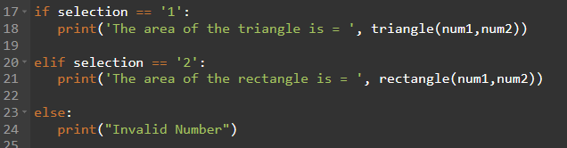
EXAMPLE: - cont.
Enter variables.
Variables for def function (a, b, c, d).
Selection.
Calling of defined function

Slide 13
Activity
Create a calculator program;
  It should display the options first (+, -, *, /).
  Then ask for the numbers.
  Print out results.
Create a program that will convert a students grade in to a percentage and out put what grade they achieved.

Slide 14
Ex – Activity 2
Create password and username log in system.
  Use subprograms to carry out validation checks, such as password length, must have caps, must have numbers etc.

Slide 15
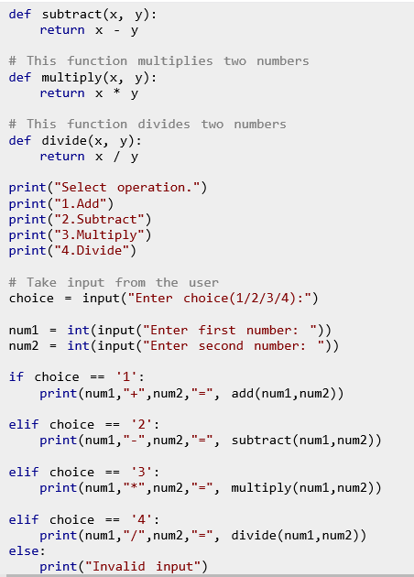
Solution Activity 1

Slide 16
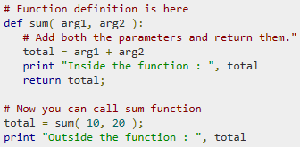
Plenary
What is subprogram?
A self-contained program of instructions that perform a specific task.
Learn how to write a subprogram.

Slide 17
Show of hand if you can make a function.
Show of hand if you know what a subprogram is?
Show of hand if you need more practice with writing subprograms.

